Slide 1
Exotic Options and Other Nonstandard Products
Chapter 22

Slide 2
Types of Exotic Options
Packages
Nonstandard American options
Gap options
Forward start options
Cliquet options
Compound options
Chooser options
Barrier options

Slide 3
Types of Exotic Options continued
Binary options
Lookback options
Shout options
Asian options
Options to exchange one asset for another
Options involving several assets

Slide 4
Packages (page 478)
Portfolios of standard options
Examples from Chapter 11: bull spreads, bear spreads, straddles, etc
Example from Chapter 15: Range forward contracts
Packages are often structured to have zero cost

Slide 5
Nonstandard American Options (page 478)
Examples:
  Exercisable only on specific dates (Bermudans)
  Early exercise allowed during only part of life (e.g. there may be an initial “lock out” period)
  Strike price changes over the life

Slide 6
Gap Options
Call pays off S_{T} − K₁ when S_{T} >K₂
Put pays off K₁ − S_{T} when S_{T} <K₂
Valued by making a small change to Black-Scholes-Merton formulas…..

Slide 7
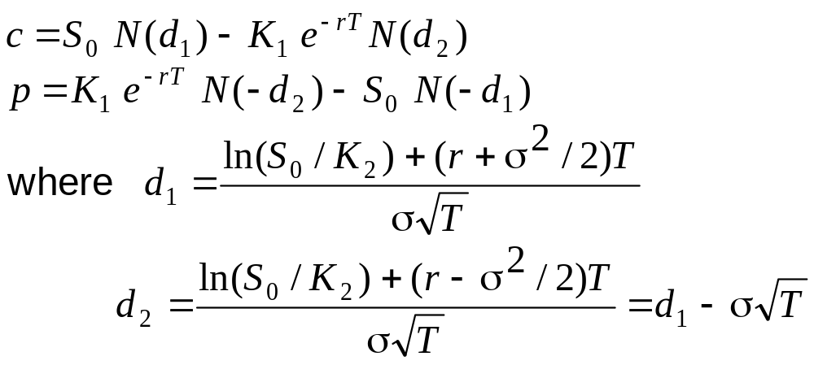
Gap Option Pricing Formulas

Slide 8
Forward Start Options (page 485)
Option starts at a future time, T
Often structured so that strike price equals asset price at time T
A plan to give at-the-money stock options to employees in each future year can be regarded as a series of forward start options

Slide 9
Cliquet Option
A series of call or put options with rules determining how the strike price is determined
For example, a cliquet might consist of 20 at-the-money three-month options. The total life would then be five years
When one option expires a new similar at-the-money is comes into existence

Slide 10
Compound Option (page 486)
Option to buy or sell an option
  Call on call
  Put on call
  Call on put
  Put on put
Very sensitive to volatility

Slide 11
Chooser Option “As You Like It” (page 480)
Option starts at time 0, matures at T₂
At T₁ (0 < T₁ < T₂) buyer chooses whether it is a put or call
A few lines of algebra shows that this is a package

Slide 12
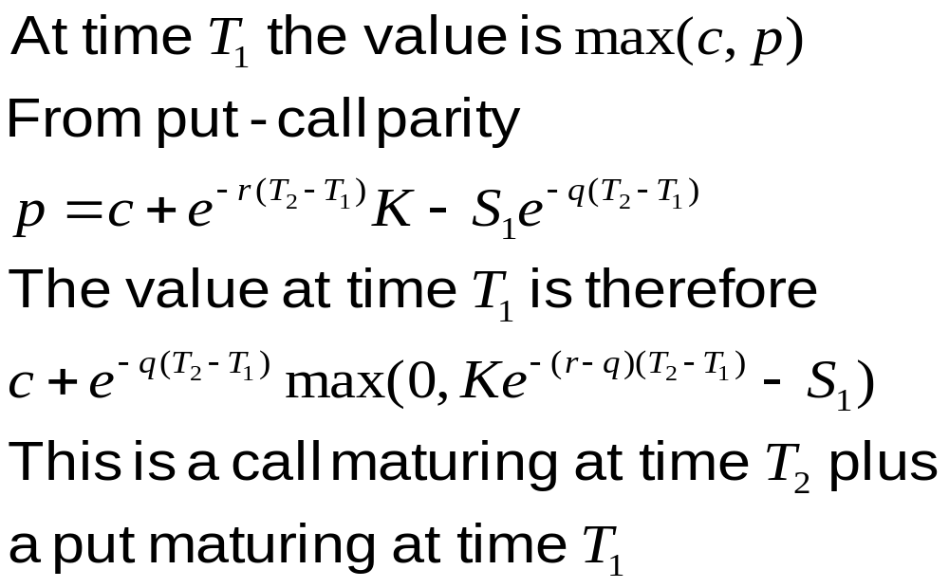
Chooser Option as a Package

Slide 13
Barrier Options (page 480-481)
In options: come into existence only if asset price hits barrier before option maturity
Out options: are knocked out if asset price hits barrier before option maturity

Slide 14
Barrier Options (continued)
Up options: asset price hits barrier from below
Down options: asset price hits barrier from above
Option may be a put or a call
Eight possible combinations

Slide 15
Parity Relations
c = c_{ui} + c_{uo}
c = c_{di} + c_{do}
p = p_{ui} + p_{uo}
p = p_{di} + p_{do}

Slide 16
Binary Options (page 481-482)
Cash-or-nothing: pays Q if S > K at time T, otherwise pays zero. Value = e^{–rT} Q N(d₂)
Asset-or-nothing: pays S if S > K at time T, otherwise pays zero. Value = S₀ e^{–qT} N(d₁)

Slide 17
Decomposition of a Call Option
Long Asset-or-Nothing option
Short Cash-or-Nothing option where payoff is K
Value = e^{–qT} S₀ N(d₁) – e^{–rT} KN(d₂)

Slide 18
Lookback Options (pages 482)
Floating lookback call pays S_{T} – S_{min} at time T
Allows buyer to buy stock at lowest observed price in some interval of time
Floating lookback put pays S_{max}– S_{T} at time T
Allows buyer to sell stock at highest observed price in some interval of time

Slide 19
Lookback Options continued
Fixed lookback call pays off the maximum asset price minus a strike price
Fixed lookback put pays off the strike price minus the minimum asset price

Slide 20
Shout Options (page 482-483)
Buyer can ‘shout’ once during option life
Final payoff is greater of
  Usual option payoff, max(S_{T} – K, 0), or
  Intrinsic value at time of shout, S_{τ} – K
Payoff: max(S_{T} – S_{τ} , 0) + S_{τ} – K
Similar to lookback option but cheaper
How can a binomial tree be used to value a shout option?

Slide 21
Asian Options (page 483)
Payoff related to average stock price
Average Price options pay:
  max(S_{ave} – K, 0) (call), or
  max(K – S_{ave} , 0) (put)
Average Strike options pay:
  max(S_{T} – S_{ave} , 0) (call), or
  max(S_{ave} – S_{T} , 0) (put)

Slide 22
Options to Exchange (page 483)
Option to exchange one asset for another
When asset with price U can be exchanged for asset with price V payoff is max(V_{T} – U_{T}, 0)
min(U_{T}, V_{T}) =V_{T} – max(V_{T} – U_{T}, 0)
max(U_{T}, V_{T}) =U_{T} + max(V_{T} – U_{T}, 0)

Slide 23
Basket Options
Options on the value of a portfolio of assets
Depends on correlations between asset returns as well as correlations between returns

Slide 24
Types of Agency Mortgage-Backed Securities (MBSs)
Pass-Through
Collateralized Mortgage Obligation (CMO)
Interest Only (IO)
Principal Only (PO)

Slide 25
Variations on Vanilla Interest Rate Swaps (page 485-486)
Examples:
  Principal different on two sides
  Payment frequency different on two sides
  Can be floating for floating instead of floating for fixed

Slide 26
Compounding Swaps (page 486-487)
Interest is compounded instead of being paid
In Business Snapshot 22.2 the fixed side is 6% compounded forward at 6.3% while the floating side is LIBOR plus 20 bps compounded forward at LIBOR plus 10 bps.

Slide 27
More Complex Swaps
  LIBOR-in-arrears swaps
  CMS and CMT swaps
  Differential swaps
These swaps cannot be correctly valued by assuming that forward rates will be realized. We must assume that the realized rate is the forward rate plus a “convexity adjustment”

Slide 28
Equity Swaps
Total return on an equity index is exchanged periodically for a fixed or floating return
See Business Snapshot 22.3 on page 489

Slide 29
Swaps with Embedded Options
Accrual swaps
Cancelable swaps
Cancelable compounding swaps

Slide 30
Other Swaps
Indexed principal swap
Commodity swap
Volatility swap
Bizarre deals: for example the P&G 5/30 swap ( See Business Snapshot 22.4 on page 491)

